Slide 1



WELCOME
Notes:
Welcome to this AIA approved course on the three KCMA certification programs for residential kitchen and bathroom cabinets –A161.1, Environmental Stewardship and Severe Use. This course earns one CEU towards the 6 required General Topic units per year.

Slide 2
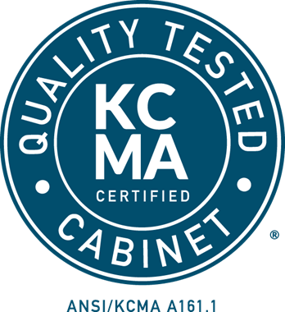

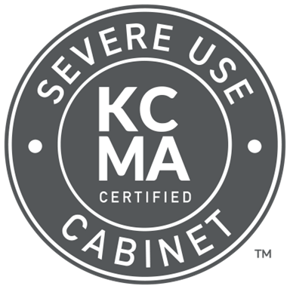
A161.1 Quality Certification
To earn the KCMA A161.1 Quality Certification Seal, cabinets must pass a series of extensive tests designed to simulate a lifetime of use. The standard was developed, and periodically revised by KCMA. The certification program was:
Developed by KCMA in 1965.
The first national construction standard for kitchen and vanity cabinets.
Nationally recognized and respected as the industry standard.
Referenced by HUD, the Department of Agriculture, the DOD, AIA, and NKBA
Environmental Certification (ESP)
In 2006, KCMA developed the Environmental Stewardship Program (ESP). The Program:
Encourages practices that benefit both the environment and the communities served by cabinet manufacturers.
Goes beyond other environmental programs through a holistic approach to certification.
Holds the industry to a higher standard for their products, forest sustainability, and manufacturing process.
Provides a tangible way for cabinet manufacturers to demonstrate their commitment to sustainability.
Severe Use Certification
The Severe Use Specifications were originally developed in 1993 by the US Department of Housing and Urban Development (HUD). KCMA took over the standard from HUD. Severe Use cabinets are appropriate for the following types of residences
High turnover apartment complexes
College Dormitories
Anywhere a higher level of abuse is expected

Slide 3
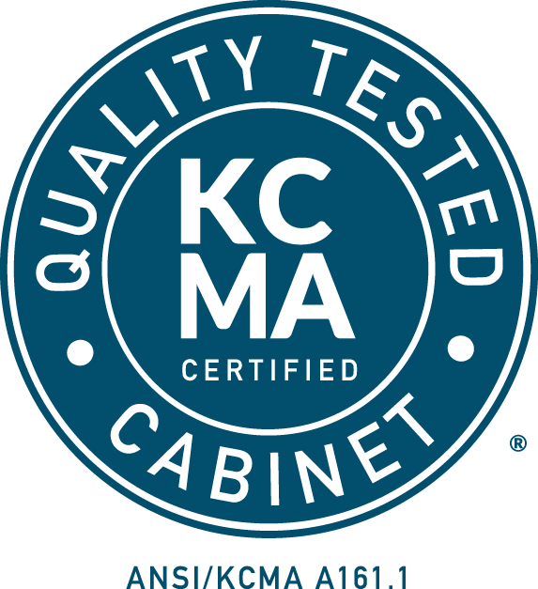
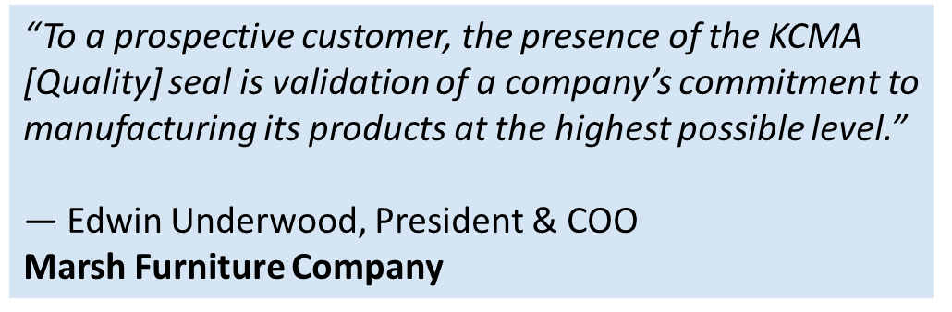
Aiga, Inc.
All Craft Fabricators, Inc.
All Wood Cabinetry
Alpine Cabinet Co.
AmberLeaf Home
American Woodmark Corporation*
ARC Cabinetry
ArtiCraft Cabinetry
Astera, Inc.
Auburn Ridge
AyA Kitchens and Baths, Ltd.
Barbosa Cabinets, Inc.
Bass Cabinet Mfg., Inc.
Bellmont Cabinet Company
Benedettini Cabinetry
Best Cabinet & Granite Supply
Bishop Cabinets, Inc.
Blue Valley Cabinets
Brighton Cabinetry, Inc.
Cabinet Craft, LLC
Cabinetry by Karman
Cabinets Northwest Corporation
Camel City
Canyon Creek Cabinet Company
Cober Cabinets
Commodore Homes
Cosmo Cabinets
Countryside Cabinets
Craft 33 Famous Supply
Crotone Kitchens
Cuisine Ideale
D12 Commercial Interiors
DDN Interior Supply
Designers Choice Kitchen TX, LLC
DL Space
Dudley Cabinets, Inc.
EcoWood Cabinetry
Euro-Rite Cabinets Ltd.
Evans Cabinet Corp.
Everything Building Products
Fowler Cabinet Company, Inc.
Green Forest Cabinetry
Greenline Supplies & Services
Hagerstown Kitchens, Inc.
Halkett Woodworking Inc.
Highland Cabinetry
Innovation Cabinetry
Island Home Building Materials
J&K Cabinetry - Georgia
JCW Company
JS International, Inc.
Kent Moore Cabinets, Ltd.
Kitchen Cabinet Distributors
Kitchen Cabinets, Inc.
Kitchen Kompact, Inc.
Kith Kitchens, LLC
Koch & Co., Inc.
Kountry Wood Products, LLC
Kunal Kitchens LLC
Lanz Cabinet Shop, Inc.
Leedo Manufacturing Co., L.P.
Legacy Cabinets, Inc.
Legacy Crafted Cabinets
LifeArt Cabinetry
Luban Cabinetry, Inc.
Magnolia Cabinetry
Markay Cabinets
Marsh Furniture Company
MasterBrand/KitchenCraft Cabinetry*
MasterBrand/Omega Cabinetry*
MasterBrand/Starmark Cabinetry*
MasterBrand Cabinets, Inc.*
MasterBuilt Cabinets
Metropolitan Cabinets & Countertops
MFS Supply
Michigan Woodwork, LLC
Mid-America Cabinets, Inc.
Monschein Industries, Inc.
Multi-Housing Depot
Nations Cabinetry
Normac Kitchens, Inc.
Panda Kitchen & Bath
Preferred Cabinet Solutions
ProCraft Cabinetry
ProCraft Cabinetry Chicago
Prodigy Cabinetry
Regent Cabinets, LLC
Republic Elite Multifamily Interiors
RiverRun Cabinetry
ROC Cabinetry
Rosebud Wood Products, Inc.
Saco Industries, Inc.
Sauder Cabinetry
Schult Homes
Shark Cabinet Inc.
Showplace Cabinetry
Sitraco
Skyline Cabinetry
Spraggins, Inc.
St. Martin America
Tribeca Cabinetry
United Finishers International, Inc.
Wellborn Cabinet, Inc.
Western Cabinets, Inc. dba Woodmont Cabinetry
WF Cabinetry
Woodcase Fine Cabinetry, Inc.
WoodConcept Cabinetry, LLC
Wren Kitchens
Zbom Cabinets Corp
*Testing into the program

Slide 4
American Woodmark Corporation*
Arbor Mills
AyA Kitchens and Baths, Ltd.
Bellmont Cabinet Company
Bertch Cabinet Mfg., Inc.
Brighton Cabinetry, Inc.
Cabico, Inc.
Cabinetry by Karman
Canyon Creek Cabinet Company
Century Cabinetry, Inc.
Century Cabinetry of Leesport
Columbia Cabinets
Countryside Cabinets
Crystal Cabinet Works, Inc.
Decor Cabinets, Ltd.
Dutch Made Cabinets
Great Northern Cabinetry
Helmuth Custom Kitchens, LLC
Holiday Kitchens
Kitchen Kompact, Inc.
Koch & Co., Inc.
Kountry Kraft, Inc.
Kountry Wood Products, LLC
Lanz Cabinet Shop, Inc.
Legacy Cabinets, Inc.
Marsh Furniture Company
MasterBrand/KitchenCraft Cabinetry*
MasterBrand/Omega Cabinetry*
MasterBrand/Starmark Cabinetry*
MasterBrand Cabinets, Inc.*
Metropolitan Cabinets & Countertops
Mouser Cabinetry, LLC
Plato Woodwork, Inc.
Precision Cabinets
R.D. Henry & Company
Rutt Quality Cabinetry
Sauder Cabinetry
Seville Cabinetry
Showplace Cabinetry
W.W. Wood Products, Inc.
Wellborn Cabinet, Inc.
Western Cabinets, Inc.
dba Woodmont Cabinetry
Woodharbor Custom Cabinetry
Woodland Cabinetry, Inc.
Wood-Mode LLC
"We are always looking for ways to 'do the right thing' when it comes to the environment and sustainability. Our company was founded on that principle, but we struggled with communicating that to our customers. The ESP Program provides us with the ability to put that message on every carton that we ship out."
Bill Allen, President & CEO
Showplace Cabinetry
*Testing into the program

Slide 5

KITCHEN & VANITY CABINETS CERTIFICATION PROGRAMS COURSE
A161.1, Environmental Stewardship, Severe Use
Notes:
Welcome to this AIA approved course on the three KCMA certification programs for residential kitchen and bathroom cabinets –A161.1, Environmental Stewardship and Severe Use. This course earns one CEU towards the 6 required General Topic units per year.

Slide 6
KCMA COURSE INFORMATION
1 General Topic LU Hour will be earned for taking this course and will be reported to AIA CES
0.1 CEU will be earned for taking this course and will be reported to NKBA upon request
A Certificate of Completion is available upon request
This course does not promote or market any KCMA products or services
Notes:
AIA requires that each course include some specific information concerning AIA approved course providers. One general topic LU hour will be earned for taking this course and, after successfully completing the exam, will be reported to AIA. A certificate of completion is available upon request. KCMA is an approved AIA course provide and this course has been reviewed and approved by AIA. This course does not promote or market any KCMA products or services.

Slide 7
COURSE DESCRIPTION
This course provides a general overview of residential kitchen and bathroom cabinet testing and certification in accordance with the KCMA/ANSI A161.1 Standard, ESP Specification and Severe Use Specification.
Notes:
This course provides a general overview of residential kitchen and bathroom cabinet testing and certification in accordance with the KCMA/ANSI A161.1 Standard, ESP Specification and Severe Use Specification.

Slide 8
COURSE OBJECTIVES
Learn about KCMA’s Certification Programs
  KCMA Quality Certification
  KCMA Severe Use Certification
  KCMA ESP: Environmental Stewardship
Get acquainted with the certification process
Learn how to specify cabinets according to KCMA standards
Learn about KCMA required performance tests
  KCMA/ANSI A161.1 Standard
  Severe Use
Notes:
The objectives of this course include learning about the three KCMA certification programs: KCMA Quality Certification, KCMA Severe Use Certification and KCMA Environmental Stewardship Certification. During the course you should get acquainted with the certification processes for each of the three programs, learn how to specify certified cabinets, and learn about the various test methods and specifications in the KCMA/ANSI A161.1 Standard and Severe Use Standard.

Slide 9
COURSE OBJECTIVES, CONT.
Learn about the Environmental Stewardship Point System
Learn how to find certified cabinet manufacturers
Notes:
Additional objectives include learning about the requirements for KCMA ESP Certification and how to find KCMA certified cabinet manufacturers.

Slide 10
KCMA Quality Certification
Notes:
The Kitchen Cabinet Manufacturers Association Quality Certification Program assures the specifier or consumer that the cabinet bearing the blue and white seal complies with the rigorous test methods contained with the KCMA/ANSI A161.1 Standard.

Slide 11
About the KCMA/ANSI A161.1 Standard
ANSI Standard is revised every five years
  KCMA follows the ANSI process for revision
    Balanced Canvass Committee with representation from General Interest, Users and Producers
Encouraged by HUD in 1965, KCMA member companies developed the precursor to the KCMA/ANSI A161.1 Standard
KCMA developed a nationally recognized testing and certification program based on the Standard
Notes:
For those of your who don’t know what ANSI is: The American National Standards Institute. It is a non-profit, privately funded membership organization that coordinates the development of U.S. voluntary national standards. ANSI approval of a standard is intended to verify that the principles of openness and due process have been followed in the approval procedure and that a consensus of those directly and materially affected by the standard has been achieved. ANSI does not write standards, they provide the framework to follow in the development and revision of standards. KCMA has assembled a balanced committee comprised of users, general interest members and manufacturers responsible for the periodic review of the KCMA/ANSI A161.1 Standard.
The development of the standard was initially encouraged by the Department of Housing and Urban Development (HUD), in response to their field auditors concerns about the quality of cabinets being used in projects under HUD’s oversight. Once the standards was developed, KCMA created a certification program based on demonstrating conformance with the test methods contained with the Standard.

Slide 12
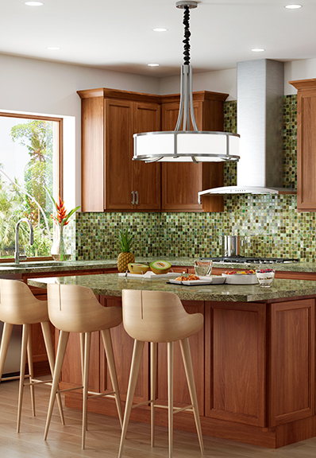
HUD Minimum Property Standards
Cabinets also comply with the provision of Paragraph 611-1.1, HUD Minimum Property Standards – Housing 4910.1
Notes:
HUD has minimum property standards for buildings constructed under HUD housing programs. This includes single and multi-family homes financed with FHA loans. HUD has specified KCMA certification for cabinets.

Slide 13
Who Can Be Certified?
The KCMA Quality Certification Program is open to all cabinet manufacturers or assemblers
Notes:
All North American cabinet manufacturers or cabinet assemblers are welcome to apply for participation in the KCMA Quality Certification Program. A North American presence is required so that cabinets can be randomly picked up for testing from either the manufacturing or assembly plant.
KCMA is unable to certify Ready to Assemble (RTA) cabinets because the performance of the cabinets during the testing is directly related to how the cabinet is assembled.

Slide 14
Locating KCMA Certification
A complete list of certification recipients and their listed lines are on:
www.kcma.org
Listing Certificates can be downloaded
Notes:
Manufacturers decide on the cabinet lines to be included in their certification. They may certify one, several, or all of their cabinet lines. Most participants elect to have all of their lines included in the listing. Certified lines are listed on the KCMA website, www.kcma.org, and the Listing Certificate for each participant can be downloaded as well.

Slide 15
KCMA/ANSI A161.1 Standard Sections
1.0 – Scope & Purpose
2.0 – General Construction Requirements
3.0 – General Test Requirements
4.0 – Hardware Requirements
5.0 – Structural Tests
6.0 – Door Operation Tests
7.0 – Drawer Operation Tests
8.0 – Finish Specifications
9.0 – Finish Tests
Notes:
Listed here are the sections contained within the KCMA/ANSI A161.1 standard. We will go over each of these in detail later in the course. As you can see, the standard covers everything from general construction requirements to testing of the cabinet finish.

Slide 16
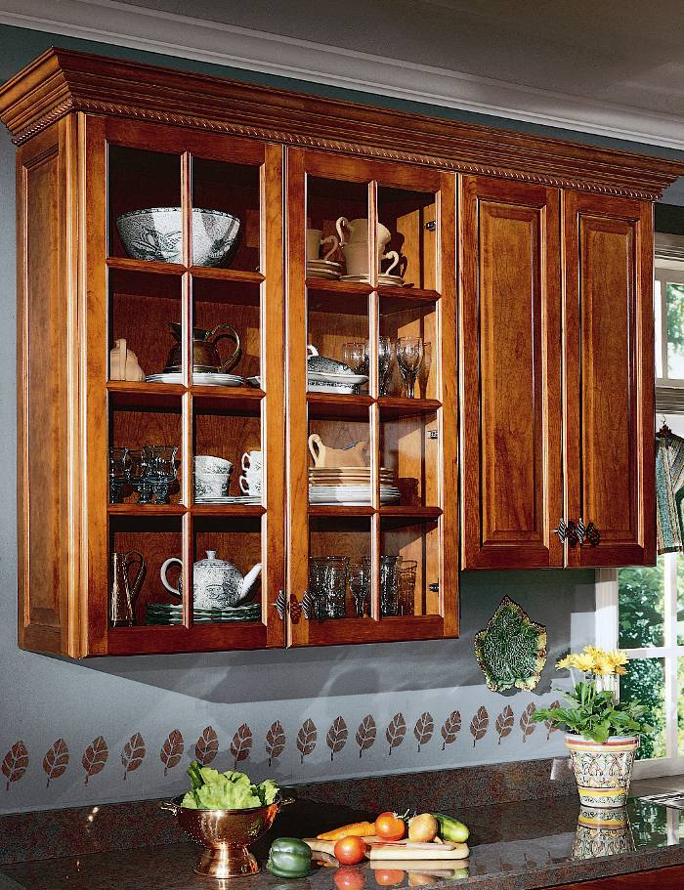
KCMA/ANSI A161.1 Standard
– Section 2:
Construction Requirements
All wall cabinets must be fully enclosed with:
  Backs
  Bottoms
  Sides
  Tops
Notes:
There are very few construction requirements in a performance standard. The intent is not to limit materials or design, provided the materials and design pass the performance tests. This is different from other specifications that focus on grades of products based on the materials used in construction and the construction techniques.
We will briefly go over the construction requirements that are contained within the KCMA/ANSI A161.1 standard. All wall cabinets need to be fully enclosed.

Slide 17
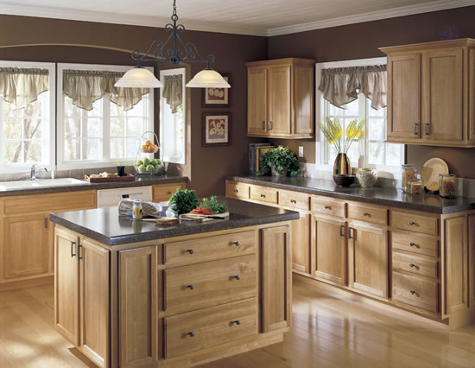
KCMA/ANSI A161.1 Standard
– Section 2: Construction Requirements
Base Cabinets Toe Kick
Notes:
All cabinets designed to rest on the floor must be provided with a toe space at least two inches deep and three inches high. When we get to the Severe Use Cabinets, this requirements changes to 3” x 3”.

Slide 18
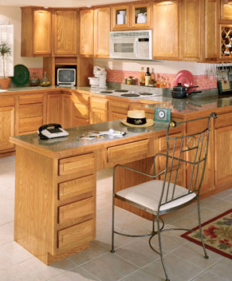
KCMA/ANSI A161.1 Standard – Section 2: Construction Requirements
Base cabinets must have:
  Backs
  Bottoms
  Sides
Notes:
All base cabinets must have backs, bottoms and sides. We will see in the next few slides there are some exceptions for specialty cabinets.

Slide 19
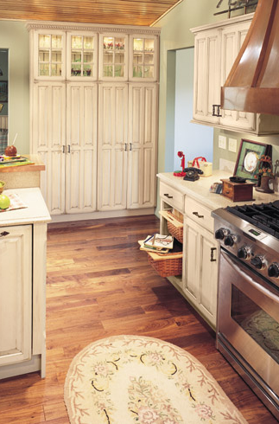
KCMA/ANSI A161.1 Standard –
Section 2:
Construction Requirements
Utility cabinets need to comply with applicable tests for wall and base cabinets
Notes:
All utility cabinets must meet the same requirements as base and wall cabinets. Exceptions are made for cabinets that need to have plumbing or wiring entering the cabinet. Utility cabinets without backs or with cut-outs in the backs are permitted.

Slide 20
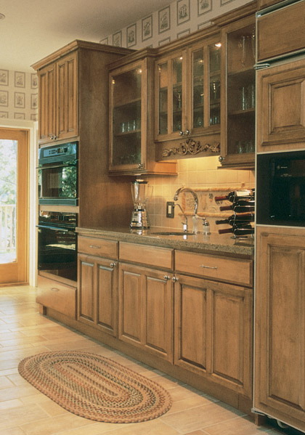
KCMA/ANSI A161.1 Standard –
Section 2:
Construction Requirements
Certain exceptions are granted for backs, bottoms and sides to kitchen sink fronts and bases, oven cabinets and refrigerator cabinets
Notes:
Refrigerator, kitchen sink and oven cabinets are also allowed to have open backs or cut-outs for plumbing and wiring.

Slide 21
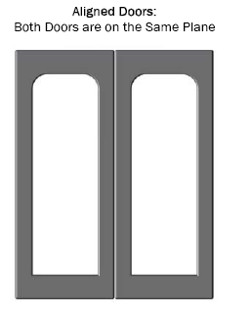
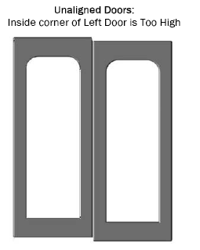
KCMA/ANSI A161.1 Standard – Section 2:
Construction Requirements
Doors must be properly aligned and close without excessive binding or looseness
Notes:
Cabinet doors must be aligned and close without excessive binding or looseness. The laboratories performing testing in support of the KCMA/ANSI A161.1 Certification are instructed to perform reasonable adjustments on the doors that are typical of an experienced installer.

Slide 22
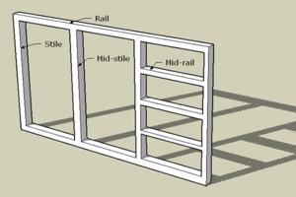
KCMA/ANSI A161.1 Standard – Section 2: Construction Requirements
All materials must ensure rigidity in compliance with performance standards
  Sections 2.6.1, 2.6.2, 2.6.3, 2.6.4
Face frames, when used, must provide rigid construction
Notes:
Whether the frames are individual or ganged, they must provide solid construction. The rigid construction requirement is determined through compliance with the structural testing requirements.
A face frame is a solid wood frame placed over the opening, which provides a square and solid foundation for cabinet hardware such as slides and hinges.

Slide 23
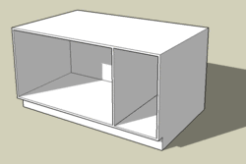
KCMA/ANSI A161.1 Standard – Section 2: Construction Requirements
For frameless cabinets, the ends, tops, bottoms and backs shall be of a thickness necessary to provide rigid construction
Notes:
Thicknesses are usually 5/8” or ¾” materials in order to maintain quality construction. With frameless construction, the hardware is mounted to the inside of the casework. Developed in Europe following WWII, frameless has become the standard in commercial case goods and has become more popular in residential casework.

Slide 24
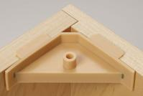
KCMA/ANSI A161.1 Standard – Section 2:
Construction Requirements
Corner or lineal bracing must be provided at points where necessary to ensure rigidity and proper joining of various components
Notes:
The KCMA/ANSI A161.1 Standard requires bracing as needed so the cabinets can withstand the structural test requirements. This is one example of bracing that adds additional reinforcement to the corner. The standard does not specify the materials used in construction, just that the cabinets must pass the testing.

Slide 25
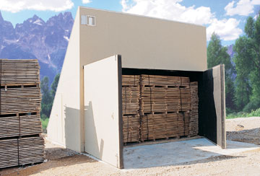
KCMA/ANSI A161.1
Standard
– Section 2:
Construction
Requirements
All wood parts must be dried to a moisture content of 10% or less at time of fabrication
Notes:
The lumber used in making the cabinets needs to have a moisture content of 10% or less. What is illustrated here is a kiln which is a type of oven used to dry out the lumber. This particular kiln is an example of ‘green’ manufacturing as it is a solar kiln.

Slide 26
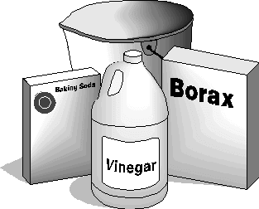
KCMA/ANSI A161.1 Standard – Section 2:
Construction Requirements
Notes:
All materials used in cabinets must be suitable for use in the kitchen and bath environment where they may be exposed to grease, solvents, water, detergent, steam and other substances usually found in these rooms. The performance tests determine if a materials is suitable for use in the construction of the cabinet.

Slide 27
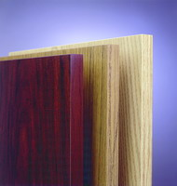
KCMA/ANSI A161.1 Standard –
Section 2:
Construction Requirements
All exposed plywood and composition board edges must be filled and sanded, edge-banded or otherwise finished to ensure compliance with the performance standards
Notes:
The unfinished surface of the cabinets must be properly prepared before the application of the finish. This includes prepping of edges by either filling and sanding or using edge banding.

Slide 28
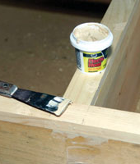
KCMA/ANSI A161.1 Standard - Section 2:
Construction Requirements
All exterior exposed parts must have nails and staples set and holes must be filled
Notes:
In addition to finishing the edges, all nails and staples must be set and the holes filled and sanded to a smooth finish.

Slide 29
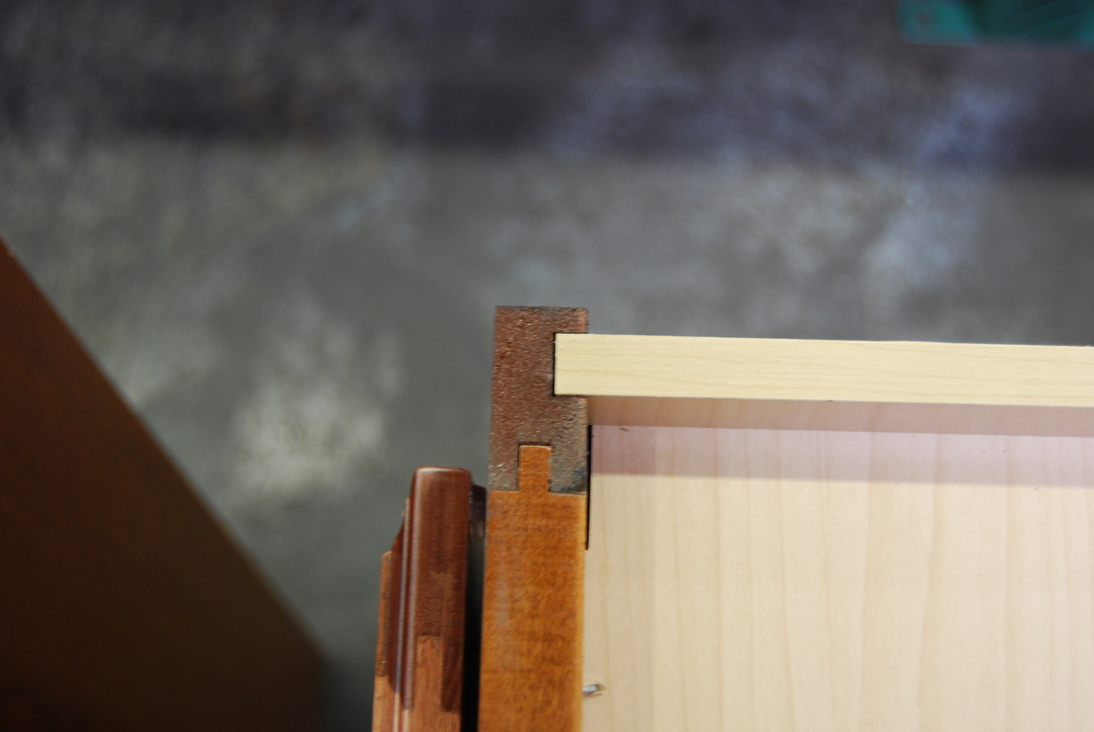
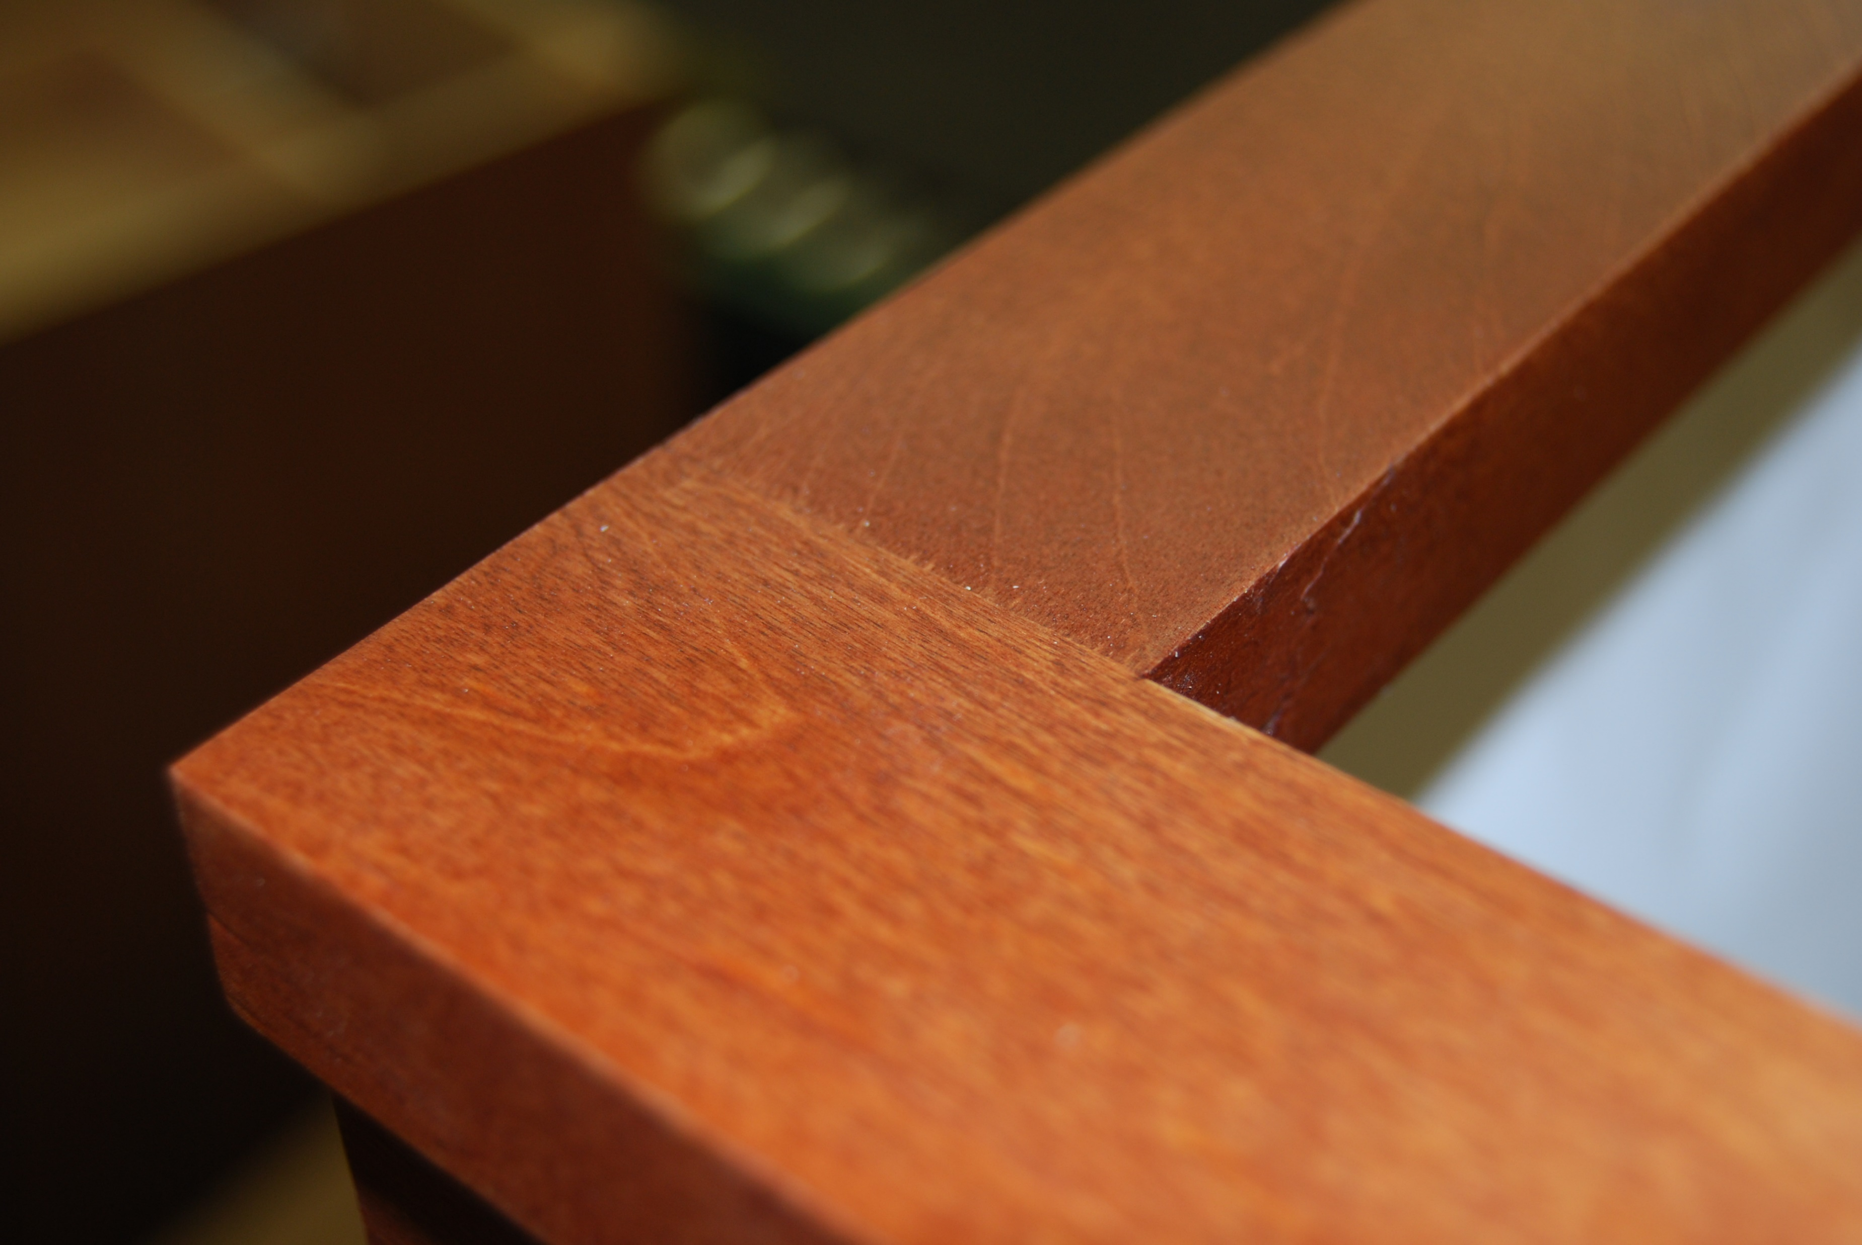
KCMA/ANSI A161.1 Standard – Section 2:
Construction Requirements
All exposed construction joints must be fitted in a manner consistent with specifications
Notes:
There are tolerances included in the KCMA/ANSI A161.1 Standard for the allowable gap in exposed joints. Those joints easily seen by the consumer require a tighter tolerance than those not easily seen. For example, joints on the face frame of the cabinet require a tighter tolerance compared to joints inside the cabinet.

Slide 30
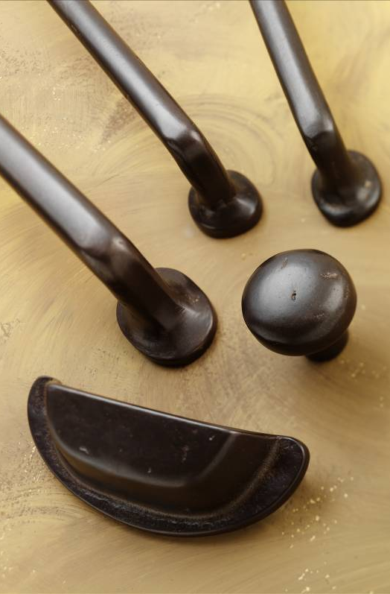
KCMA/ANSI A161.1 Standard –
Section 2:
Construction Requirements
Exposed cabinet hardware must comply with Builders Hardware Manufacturing Association finishing standards
Notes:
The BHMA maintains standards for different finishes on different base metals. The manufacturer is required to provide proof of compliance for all hardware used in making the cabinets from the hardware supplier.

Slide 31
KCMA/ANSI A161.1 Standard – Section 5:
Structural Tests
5.1 – Static Load Shelves & Bottom
5.2 – Wall Load
5.3 – Base Front Joint Load
5.4 – Impact on Shelves, Cabinet Bottoms and Drawer Bottoms
5.5 – Impact on Base Door
Notes:
There are five structural tests in the KCMA/ANSI A161.1 Standard. These test the structural abuse a typical user will subject the cabinets to. We’ll go over each in detail.

Slide 32
Poll Time!

Slide 33
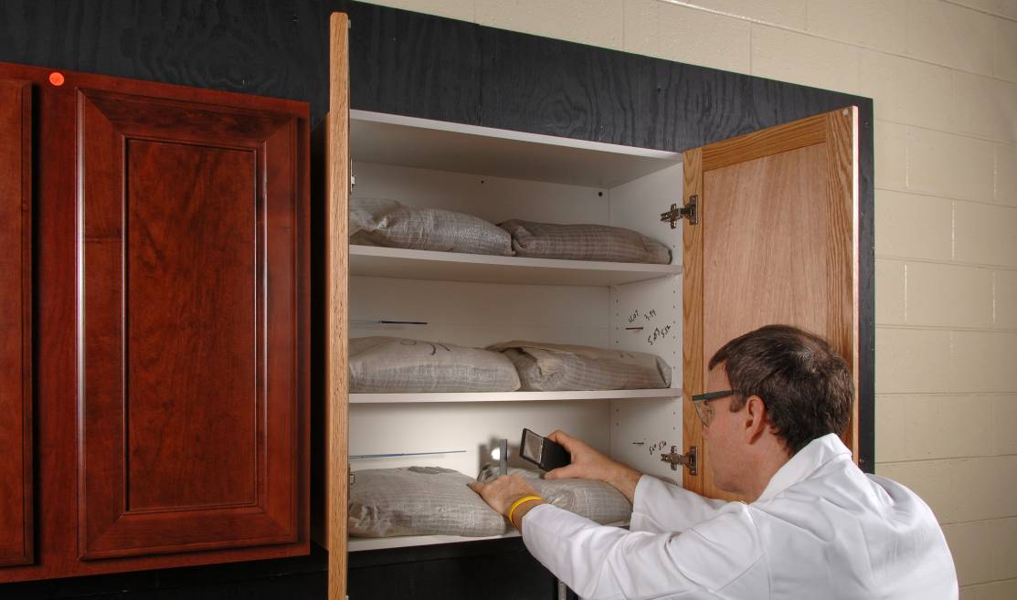
KCMA/ANSI A161.1 Standard – Section 5.1:
Structural Tests – Static Load
Notes:
Section 5.1 requires all shelves and bottoms are loaded at 15 pounds per square foot, and loading is maintained for seven days to ensure that there is no excessive deflection and no visible sign of joint separation or failure of any part of the cabinets or the mounting system. This is a long term load test to make sure the shelves will not experience excessive deflection under load.

Slide 34
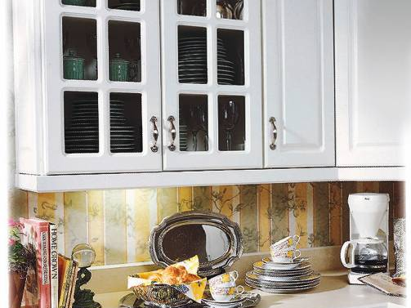
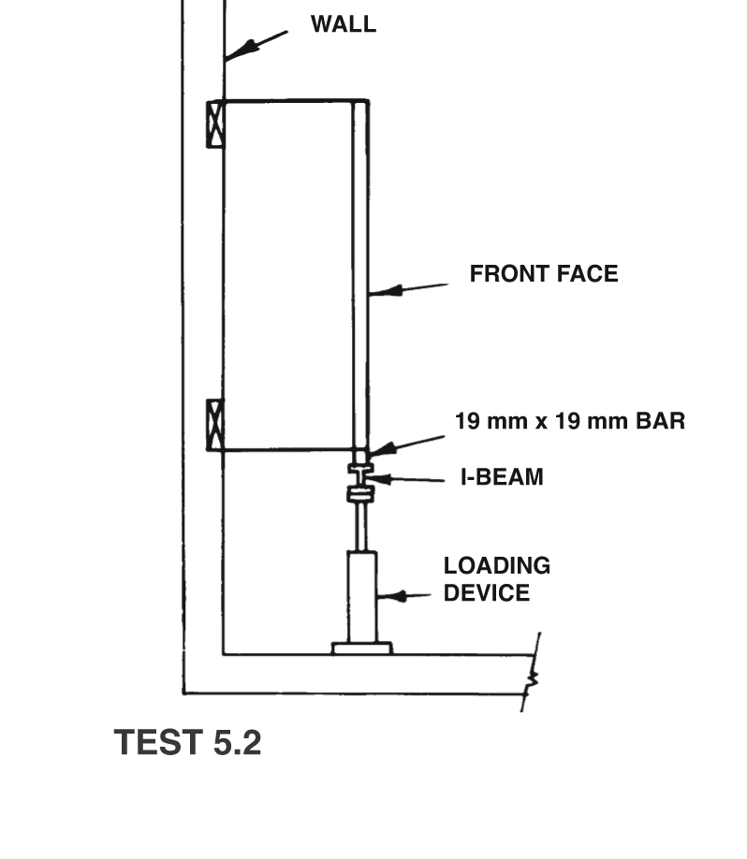
KCMA/ANSI A161.1 Standard – Section 5.2:
Structural Tests – Wall Load
Notes:
Section 5.2 of the Standard – mounted wall cabinets are gradually loaded to 600 pounds without any visible sign of failure in the cabinet or the mounting system. Cabinets can be loaded with quite a few dishes or canned goods. This test method determines if the cabinet can withstand excessive loading.

Slide 35
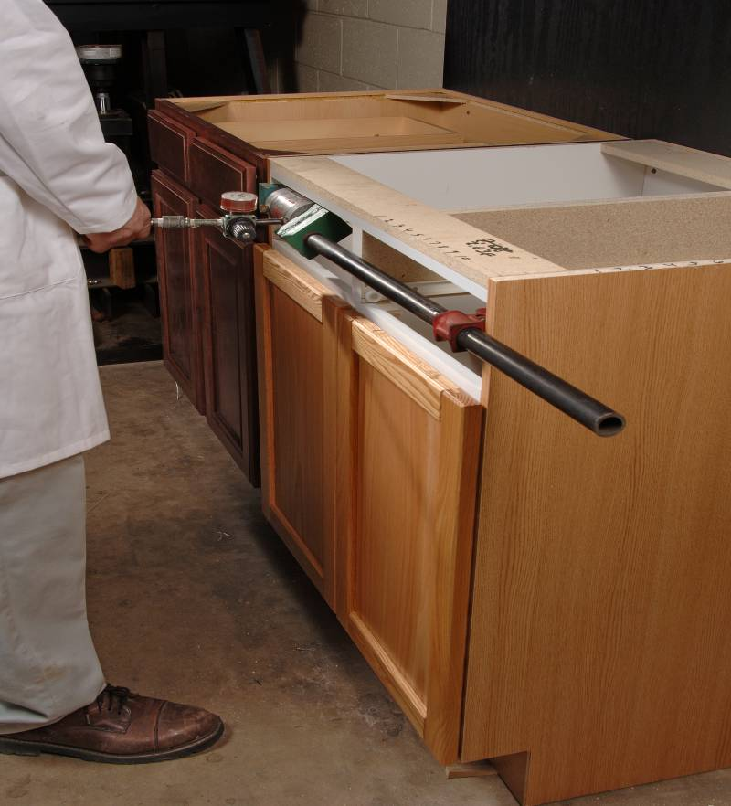
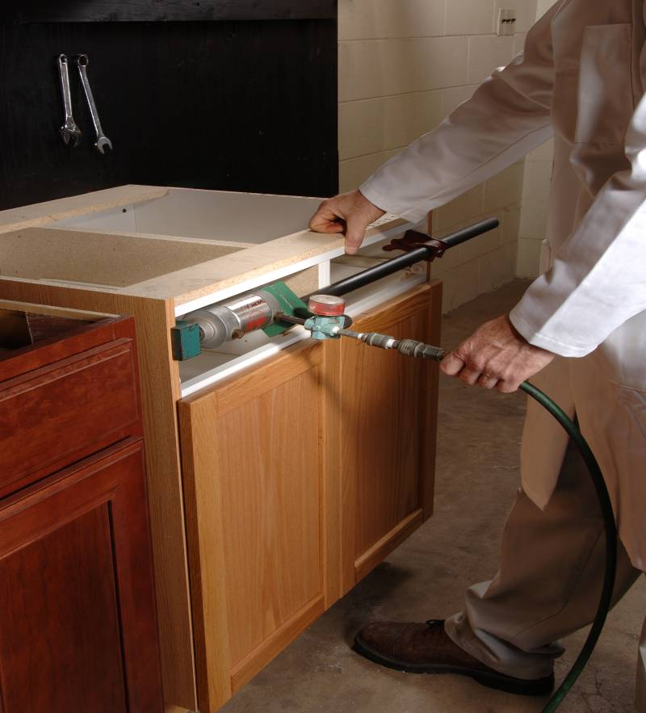
KCMA/ANSI A161.1 Standard – Section 5.3:
Structural Tests - Base Front Joint Load
Notes:
Section 5.3 tests the strength of base-front joints, a load of 250 pounds is applied against the inside of cabinet-front stiles for cabinets with drawer rail, or 200 pounds is applied for cabinets without drawer rail. During installation when cabinets are screwed together, the front joints can be put under a bit of stress. This test determines if the joints can withstand the stresses.

Slide 36
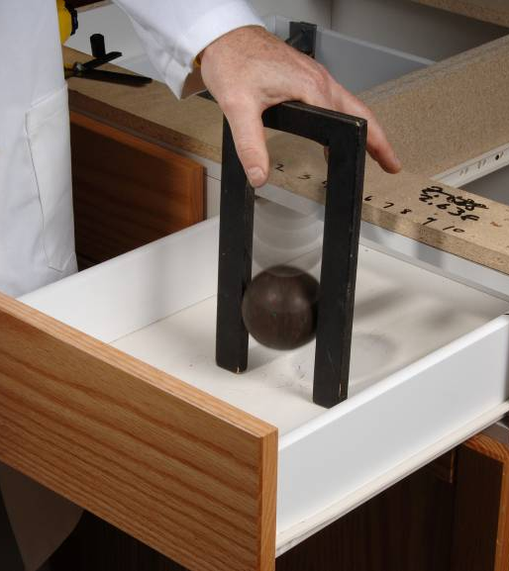
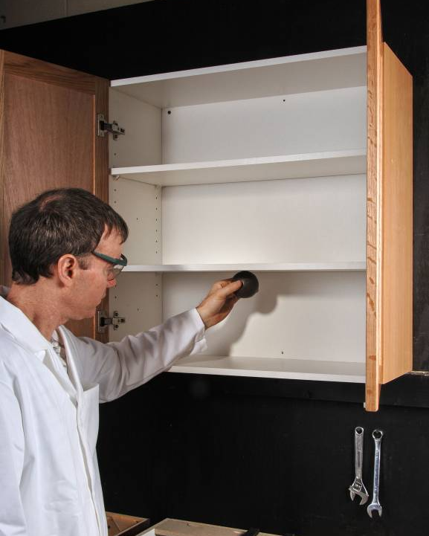
KCMA/ANSI A161.1 Standard – Section 5.4:
Structural Tests – Impact Tests
Notes:
Section 5.4 tests the ability of shelves, bottoms and drawer bottoms to withstand the dropping of cans and other items, a three-pound steel ball is dropped from six inches above the surface. After the test, the drawer must not be damaged and must operate as before the test with no visible sign of joint separation or failure of any part of the cabinet or mounting system.

Slide 37
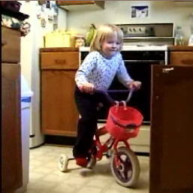
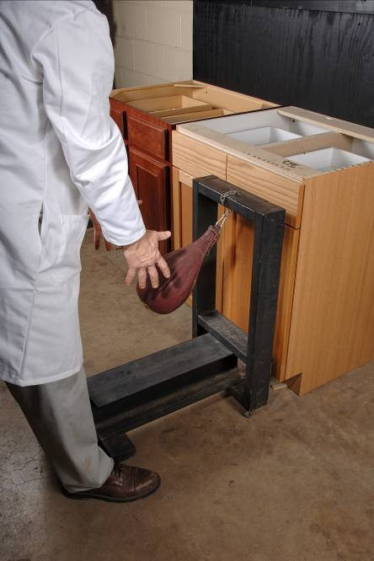
KCMA/ANSI A161.1 Standard – Section 5.5: Structural Tests – Impact Tests
Notes:
Section 5.5 tests the ability of cabinet doors and connections to withstand impacts, a 10-pound sandbag is used to strike the center of a closed cabinet door and repeated with the door opened to a 45-degree angle. The door must operate as before the test and show no damage or sign of separation or failure in the system. This simulates the impacts a base cabinet door might encounter.

Slide 38
KCMA/ANSI A161.1 Standard – Section 6:
Door Operation Tests
6.1 – Door Cycling: Door Racking & Hinge Set
6.2 – Door Load Test: Door Holding Devices & Hinge Operation
Notes:
Section 6 of the Standard focuses on the structural integrity of the door and how it is mounted to the cabinet. There are two test methods performed for door operation, one is a long term cycling test and the other is a load test.

Slide 39
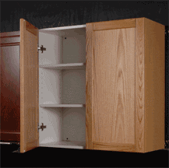
KCMA/ANSI A161.1 Standard –
Section 6.1:
Door Operation Tests - Door Cycling
Notes:
To test the ability of doors, door-holding devices, hinges and attachment devices to operate under the stress of normal use, doors are opened and closed through a full 90-degree to 20-degree swing for 25,000 cycles.
At the test’s conclusion, the door must be operable, the door-holding device must hold the door in closed position, hinges must show no visible signs of damage, connections between cabinet-and-hinge and door-and-hinge must show no sign of looseness, and other specifications must be met

Slide 40
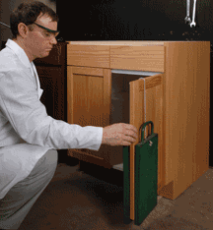
KCMA/ANSI A161.1 Standard – Section 6.2: Door Operation Tests – Door Load Test
Notes:
The load test requires the doors, hinges and means of attachment to withstand loading. 65 pounds of weight is applied to the door. The weighted door is slowly operated for 10 cycles from 90-degrees open to 20-degrees open and returned to the 90-degree position. The door must remain weighted for 10 minutes, after which the door and hinges must show no visible signs of damage, and connections between cabinet-and-hinge and door-and-hinge must show no sign of looseness.

Slide 41
KCMA/ANSI A161.1 Standard – Section 7:
Drawer Tests
7.1 – Drawer Cycling
7.2 – Drawer Closing Impact
Notes:
Section 7 is very similar to Section 6, but it focuses on the drawer operation and the impact the drawer front will experience when it is closed.

Slide 42
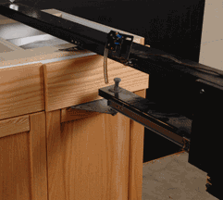
KCMA/ANSI A161.1 Standard – Section 7:
Drawer Tests – Drawer Cycling
Notes:
Section 7.1 tests the ability of drawers and drawer mechanisms to operate with loading during normal use, drawers are loaded at 15 pounds per square and operated through 25,000 cycles. The drawers must then remain operable with no failure in any part of the drawer assembly or operating system, and drawer bottoms must not be deflected to interfere with drawer operation.

Slide 43
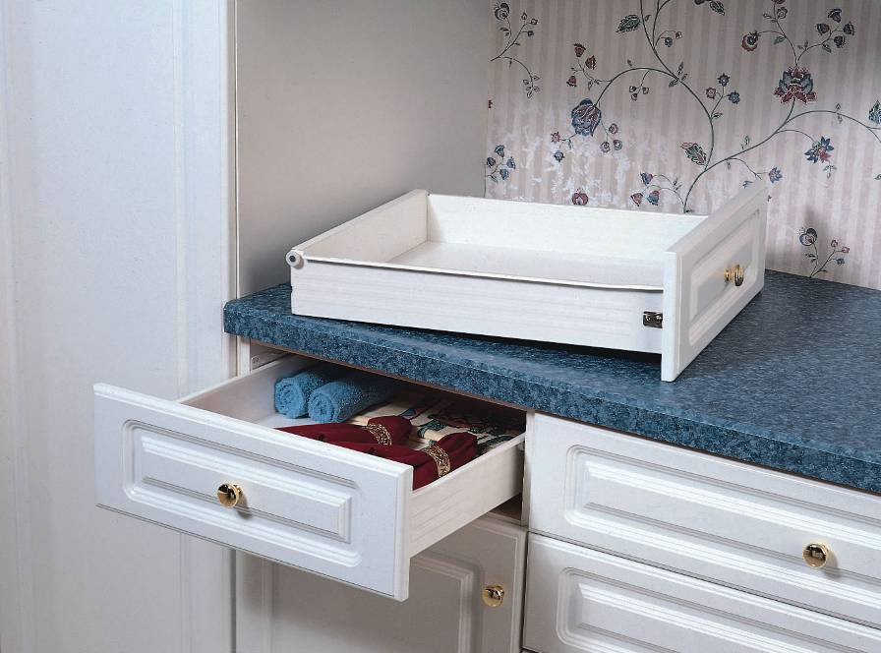
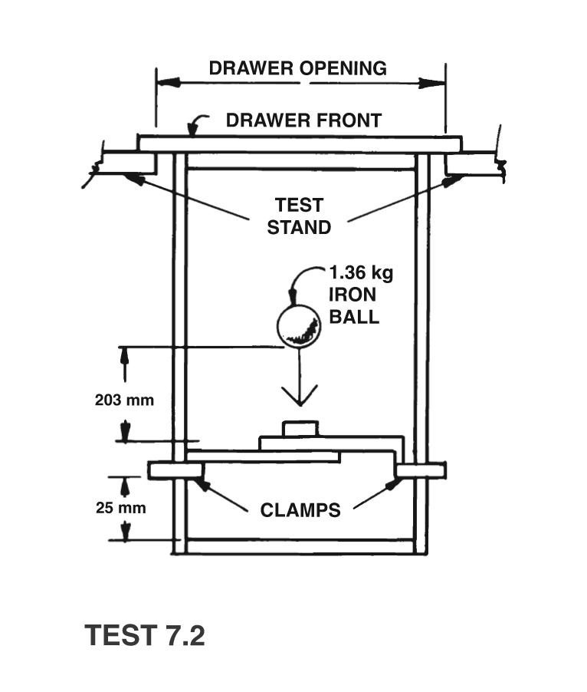
KCMA/ANSI A161.1 Standard – Section 7:
Drawer Tests – Drawer Closing Impact
Notes:
Section 7.2 tests the drawer front assembly. It must withstand the impact of closing the drawer under normal use. The drawer front is typically attached to the drawer box with screws and the drawer front is used to stop the drawer against the cabinet frame when closed. If the drawer is heavily weighted, quite a bit of stress can be placed on the attachment of the drawer front to the drawer box if closed forcibly.

Slide 44
KCMA/ANSI A161.1 Standard – Section 8:
Finish Specifications
Exposed Surfaces
  Free of saw marks
  Fully finished
  Finish free of imperfections
  Nails and staples set and holes filled
  Cabinet finishes are inspected to ensure that stringent standards of appearance are met
Notes:
Chapter 8 details the requirements for the cabinet finish. The appearance of the cabinet must be acceptable to the average consumer. All exposed surfaces must be free of saw marks, be fully finished without imperfections, and all nails and staples set, filled and finished. The laboratories performing the testing us a standard observation procedure when inspecting the cabinets finish.

Slide 45
KCMA/ANSI A161.1 Standard – Section 9:
Finish Tests
Six finish tests are performed
  Shrinkage & Heat Resistance
  Hot & Cold Check Resistance
  Chemical Resistance
  Detergent & Water Resistance
  Metal Cabinet Rust Resistance
  Water Holdout of Interior Surfaces
Notes:
Chapter 9 tests the finish applied to the cabinet and makes sure the finish will not fail given what it will be exposed to during the lifetime of the cabinet. There are six separate finish tests.

Slide 46
KCMA/ANSI A161.1 Standard – Section 9:
Finish Tests – Shrinkage & Heat Resistance
24 hour exposure to 120℉ / 70% relative humidity
  Finish shall show no signs of damage
Notes:
Section 9.2 tests the ability of the finish to withstand hot and humid conditions for a prolonged period of time. A cabinet door is placed in a hotbox at 120 degrees Fahrenheit and 70 percent relative humidity for 24 hours, removed and allowed to return to room temperature and humidity conditions. The finish must then show no appreciable discoloration and no evidence of blistering, cold checking, or other film failure. This simulates the extreme conditions cabinets may be subjected to during shipping in the south from the manufacturing plant to the job site.

Slide 47



KCMA/ANSI A161.1 Standard –
Section 9: Finish Tests –
Hot & Cold Check Resistance
Hotbox at 120℉ and 70% relative humidity for one hour
Return to room temperature and humidity
Cold box at -5℉ for one hour
Repeated 5 times
It’s KCMA
Certified!
Notes:
Section 9.3 tests the ability of the finish to withstand hot and cold cycles for prolonged periods. A cabinet door is placed in a hotbox at 120 degrees Fahrenheit and 70 percent relative humidity for one hour, removed and allowed to return to room temperature and humidity conditions, and then placed in a coldbox for one hour at -5 degrees Fahrenheit. The cycle is repeated five times. The finish must then show no appreciable discoloration and no evidence of blistering, cold checking, or other film failure. This test simulated what a cabinet might be subjected to when shipping from one extreme condition to another between the manufacturing plant and the job site.

Slide 48
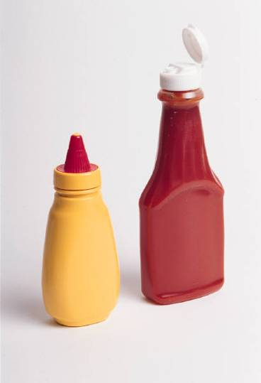

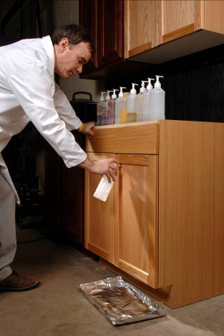
KCMA/ANSI A161.1 Standard – Section 9:
Finish Tests – Chemical Resistance
Lemon, Orange and Grape juice, Vinegar, Ketchup, Coffee, Olive Oil, Alcohol, Detergent Solution, Yellow Mustard
Notes:
Section 9.4 tests the ability of the finish to withstand stains and chemicals typically found in the kitchen and bath, exterior exposed surfaced of doors, front frames, drawer fronts and end panels are subjected to vinegar, lemon, orange and grape juices, tomato ketchup, coffee, olive oil, and 100-proof alcohol for 24 hours and mustard for one hour. After this test, the finish must show no appreciable discoloration, stain, or whitening that will not disperse with ordinary polishing and no indication of blistering, checks, or other film failure.

Slide 49
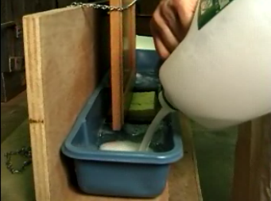
KCMA/ANSI A161.1 Standard – Section 9:
Finish Tests – Water Resistance
Notes:
Section 9.5 tests doors resistance to exposure to moisture. The door must resist 24-hours of exposure to a detergent and water solution. This simulates hanging a wet dish towel on the door to dry.
The door edge must then show no delamination or swelling and no appreciable discoloration or evidence of blistering, checking, whitening, or other film failure.

Slide 50
KCMA/ANSI A161.1 Standard – Section 9:
Finish Tests – Metal Cabinet Rust Resistance
Scratched to bare metal with a razor blade
  12 day exposure of scratched panel to 100℉ and 100% relative humidity
  Rust creepage shall not exceed 1/16th inch
Notes:
Section 9.6 is for metal cabinets. If the surface of a metal cabinet gets scratched, only minimal rusting is permitted. The cabinet is scratched with a razor blade and then exposed to 100 degrees Fahrenheit and 100% relative humidity for 12 days.

Slide 51
KCMA/ANSI A161.1 Standard – Section 9:
Finish Tests – Water Holdout of Interior Surfaces
Test for damage due to mugs/cups, dishes going from a hot dishwasher directly onto a shelf
Ceramic coffee cup dipped in boiling water for 5 seconds and placed on a shelf
No damage due to exposure
Notes:
Section 9.7 tests the shelves ability to resist damage from cups and plates going directly from the dishwasher to a shelf. A ceramic coffee cup is dipped in boiling water and then placed on the shelf for 24 hours. At the end of the 24 hour time period, there shall be no damage on the shelf.

Slide 52
KCMA A161.1 Quality
Certification Program Structure
Compliance with KCMA/ANSI A161.1 standard is assured by:
  Initial cabinet testing
  Periodic unannounced plant pick-up and testing
  Additional testing resulting from complaints
  All testing is performed by experienced, accredited and independent laboratories
Notes:
Certification is initiated with random selection of cabinets for complete KCMA/ANSI A161.1 testing. Testing is typically performed on a 30” base cabinet and a 30” X 30” wall cabinet. Based on the extent of the cabinet lines to be certified, there will be additional testing done to make sure all the various materials and construction techniques comply with the standard. Six months after the initial testing, another round of testing is performed. If all goes well with the 6 month test, the certification participant goes to annual testing.

Slide 53
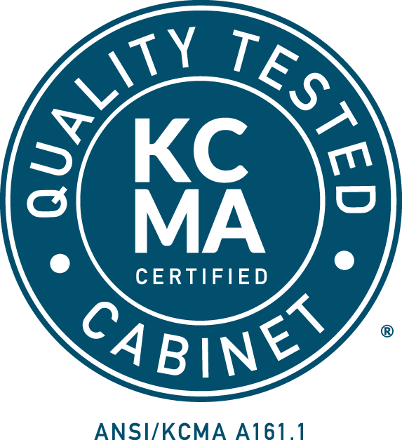
KCMA A161.1 Quality
Certification Program Structure
Companies passing the tests are awarded:
  Certification
  Right to be listed in the online directory
  Use of Certification Seal
Notes:
Companies successfully passing the testing receive certification. They are added to the online listing directory at www.kcma.org and can now use the KCMA/ANSI A161.1 certification seal on their listed cabinets.

Slide 54
Poll Time!

Slide 55
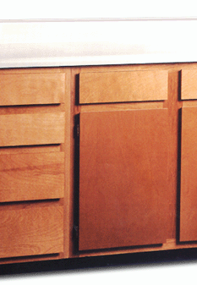
KCMA
Severe Use Cabinets
Used mostly in subsidized housing
Used where the opportunity for abuse is high
Built for extreme durability, not looks
Still must meet the requirements of KCMA/ANSI A161.1 Standard, plus additional specifications outlined by KCMA’s Severe Use Specifications
Notes:
The second certification program KCMA offers is for Severe Use Cabinets. Severe Use Cabinets are made with materials and construction techniques that make them very durable, although usually not that attractive. A prerequisite for participation in the Severe Use Program is the cabinets must be KCMA A161.1 Quality Certified.

Slide 56
KCMA
Severe Use Cabinets
Severe Use Specification initially issued by HUD in 1993
HUD never published the Severe Use Specification in the Federal Register
HUD turned the Severe Use Specification over to KCMA
Notes:
The Severe Use Specification were initially developed through the Department of Housing and Urban Development (HUD). HUD never published the Severe Use specifications in the Federal Register and decided to turn them over to KCMA. HUD no longer has an interest or input into the Severe Use Specifications and KCMA has the sole responsibility for the oversight and revision of the specifications.

Slide 57
KCMA
Severe Use Cabinets
Specific Materials Used In Construction
  Cabinet Box
    Either Solid Wood or Exterior Grade Plywood
    Areas in contact with floor – Pressure Treated
  Face Frames
    ¾” Solid Lumber
    Extra Reinforcement
Notes:
Severe Use Cabinets must be constructed with specific materials. The cabinet box must be constructed with either solid wood or exterior grade plywood. All parts of the cabinet that comes in contact with the floor must be pressure treated. The cabinets face frames must be made with ¾ “ thick solid lumber.

Slide 58
KCMA
Severe Use Cabinets
Specific Materials Used In Construction
  Wood Doors
    Either 7-ply A-1 plywood or solid wood
    Reversed Edge for continuous finger grip
    180 degree Hinges
Notes:
The doors on severe use cabinets must be either solid wood or 7-ply A-1 plywood. The doors must have a reverse edge to allow opening by hand without the need for door and drawer pulls. The hinges must allow for full opening of the door.

Slide 59
KCMA
Severe Use Cabinets
Specific Materials Used In Construction
  Drawers
    Drawer box French dovetail or mortise and tenon
    Drawer box minimum 11/16” thickness solid lumber
    Drawer face same construction requirements as doors
Notes:
Severe Use cabinet drawers are required to be assembled using either French dovetail or mortise & tenon construction. The drawer box must be made with minimum 11/16” thick solid lumber and the drawer face must be of the same construction as the doors.

Slide 60
KCMA
Severe Use Cabinets
Specific Materials Used In Construction
  Hang Rail
    Minimum ¾” x 3 ½” x full width of cabinet
    Solid lumber
  End Panels
    Minimum 5-ply Exterior Grade Plywood
Notes:
The hang rail on severe use cabinets is a minimum of ¾” x 3 ½” x full width of cabinet and constructed of solid lumber. The end panels need to be a minimum 5-ply exterior grade plywood.

Slide 61
KCMA
Severe Use Cabinets
Specific Materials Used In Construction
  Shelves
    Set into dadoes of end panels and braced behind mulls
  Base Bottoms
    Minimum ½” exterior grade plywood
  Backs
    Minimum ¼” exterior grade plywood
Notes:
Severe Use Cabinet shelves need to eb set into dadoes cut into the end panels and the shelves need to be braced behind mulls. The bottom of the base cabinet must be a minimum ½” thick exterior grade plywood and the backs on all severe use cabinets needs to be a minimum ¼” exterior grade plywood.

Slide 62
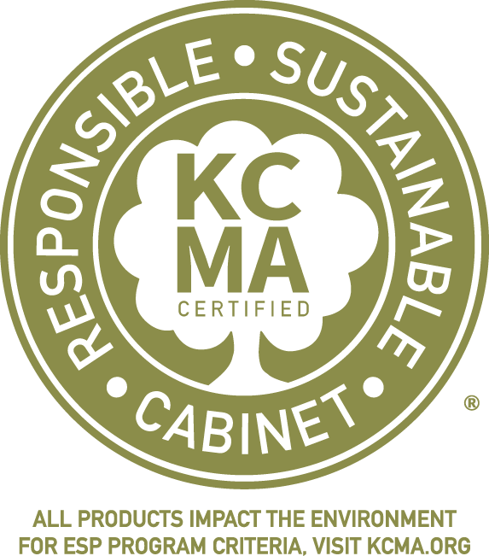
Environmental Stewardship Program (ESP)
Notes:
The third KCMA Certification Program is the Environmental Stewardship Program, also known as ESP. Shown on this slide is the official ESP Certification Logo. This logo will be on the certification seal of all ESP certified cabinets.

Slide 63
KCMA ESP Certification
Designed to encourage industry policies and practices that benefit both the environment and the well-being of society, ESP provides companies with tangible ways to support sustainability in the areas of Air Quality & Pollution Prevention, Resource Sustainability, Waste Minimization, Environmental Stewardship, and Community Relations. Companies qualify for ESP Certification by accumulating at least 70 points in the categories above.
Notes:
Certification in accordance with the ESP is prescriptive based. Manufacturers earn points towards certification by employing specific practices in their sourcing of materials, manufacturing and community relations.

Slide 64
KCMA ESP Certification
Do not have to be a KCMA member to participate
5 sections, 29 different criteria
  Air quality & Pollution Prevention
  Resource Sustainability
  Waste Minimization
  Environmental Stewardship
  Community Relations
Visit www.kcma.org for more information
Notes:
Prescriptive based ESP Certification requires participants to earn points in all five sections of the ESP Specification. The five sections are: Air quality & pollution prevention, resource sustainability, waste minimization, Environmental Stewardship and Community Relations. Next, we will go over each of these sections in detail.

Slide 65
KCMA ESP Certification: Air Quality & Pollution Prevention
5 points for using an exempt resin system defined in TSCA Title VI in the production of laminated products
5 points for having an energy conservation program
5 points for meeting or exceeding source reduction and waste management goals in the Toxic Release Inventory Form R
5-15 points for having Environmental Product Declarations
Notes:
The first section of the ESP Specification is Air Quality & Pollution Prevention. Participants can earn 5 points if they produce laminated products and the resins used are exempt as defined in TSCA Title VI. 5 points can be earned if the manufacturer has in place an energy conservation program and 5 points can be earned if they meet or exceed source reduction and waste management goals reported to the EPA.
5-15 points can be earned if the participant has developed Environmental product declarations.

Slide 66
KCMA ESP Certification: Resource Sustainability
10 points each for 80% compliance of particle board, MDF, or plywood with CPA’s ECC 4-11 or Benchmark CWSS standard
5-10 points for Manufacturer having Chain of Custody Certification through a recognized sustainable forestry program
Points awarded for manufacture or purchase of materials that are Chain of Custody certified through a recognized sustainable forestry program
Points awarded for manufacture or purchase of materials Certified Sourcing through a recognized sustainable forestry program
Notes:
The second section of the specification is Resource Sustainability. 10 points can be earned towards certification for purchasing particle board and medium density fiberboard (MDF), that is certified to comply with either CPA’s ECC 4-11 or Benchmark’s CWSS standard. The ECC 4-11 and CWSS are standards that require the materials used in the production of the particle board and MDF be environmentally sustainable. This includes having a small carbon footprint, be locally sourced, sourced from recycled/recovered materials, and sourced through a recognized forestry certification program for sustainability.
Points can also be earned in this section if the manufacturer has Chain of Custody Certification or if the manufacturer purchases materials that have Chain of Custody certification. If the manufacturer purchases materials that are certified sourcing through a recognized sustainable forestry program points can be earned.

Slide 67
KCMA ESP Certification:
Resource Sustainability
Points for Chain of Custody (COC) certification through a recognized sustainable forestry program for wood products purchased.
  SFI: Sustainable Forestry Initiative
  FSC: Forest Stewardship Council
  ATFS: American Tree Farm System
Notes:
SFI FSC and ATFS are several ESP recognized Chain of Custody certification programs.

Slide 68
KCMA ESP Certification:
Resource Sustainability
5 points for training suppliers on their preference for purchasing certified hardwood lumber
5 points for 100% of laminated products purchased that use a TSCA Title VI exempt resin system
10 points for having a documented wood trade compliance or due diligence policy
5 points for a policy that prohibits the use of wood species on the CITES list
Notes:
Participants can also earn 5 points in the Resource Sustainability section for having annual training of suppliers on their preference for purchasing certified hardwood lumber. The training needs to be written and documented. 5 points can be earned if 100% of the laminated products purchased use a TSCA Title VI exempt resin system. If the participant has a documented wood trade compliance or due diligence policy points can be earned as well as having a policy that prohibits the use of wood species on the CITES list.

Slide 69
KCMA ESP Certification:
Waste Minimization
10 points for a Comprehensive Recycling Program for at least three of the following: Cardboard, Paper, Plastic, Wood, Solvents, Metal
Notes:
The third section of the ESP is Waste minimization. This section deals with what happens inside the manufacturing plant. Points can be earned towards certification for having a comprehensive recycling program. At least three of the following must be recycled to earn points: cardboard, paper, plastic, wood, solvents and metal. Participants are required to provide pick up tags indicating the type and amount of materials recycled.

Slide 70
KCMA ESP Certification:
Waste Minimization
10 Points – Program for tracking and reducing process waste with documented goals and reports
5 Points – By-products of manufacturing used to generate energy
5 Points – having a program for reclaiming cabinets and recycling, reusing, or repurposing them
Notes:
Points can also be earned in Waste Minimization for tracking and reducing process waste. There needs to be documented goals and reports submitted in support of the claimed points.
If by-products of production are used to generate energy, points can be earned. Many manufacturing plants either burn their sawdust and scrap to generate steam/electricity or ship that material to an external facility that does.
If there is a program in place for reclaiming cabinets removed during a remodel and either recycling, reusing, or repurposing them, points can be earned.

Slide 71
KCMA ESP Certification:
Environmental Stewardship
5-15 points for having an Environmental Management System in place
5 points – Manufacturer reviews environmental practices and policies of its key vendors and contractors
5 points – Documented program which promotes the use of renewable/recycled materials or products
5 points – Manufacturer is enrolled in EPA SmartWay Transport Partnership as a registered partner
Notes:
The fourth section of the ESP is Environmental Stewardship. Points can be earned towards certification for having either a certified or non-certified Environmental Management System in place. An Environmental Management System is a comprehensive program that demonstrates the company has reduced its environmental impact and increased its operating efficiency. A typical certification for an Environmental Management System is ISO 14001.
Points can also be earned in the fourth section of the ESP, Environmental Stewardship, if the participant reviews the environmental practices and policies of their key vendors and contractors.
If the participant promotes the use of renewable and/or recycled materials or products in the manufacturing plant points can be earned towards certification.
Participation in EPA’s SmartWay Transport Partnership as a registered partner can earn points towards certification. Shipping products with a registered SmartWay partner is more efficient and has less of an environmental impact compared to using a non-registered shipping company.

Slide 72
KCMA ESP Certification:
Environmental Stewardship
10 points for having a documented corporate social responsibility or environmental social governance report
5 points for having an environmental sustainability strategic plan
5-15 points for having Health Product Declarations for the cabinetry
Notes:
Points can also be earned in the Environmental Stewardship section if there is a documented corporate social responsibility or environmental social governance report. If the participant has an environmental sustainability strategic plan, they can earn 5 points towards certification. In addition, 5-15 points can be earned if there are health product declarations for the cabinetry.

Slide 73
KCMA ESP Certification:
Community Relations
5 points – Community involvement and leadership through service or donation to charitable organizations
5 points – Manufacturer has had no major non-compliance citations from any federal, state or local environmental regulatory agency in the previous 12 months
5 points for highlighting environmental initiatives on their website and using the ESP logo on the home page
Notes:
The fifth and final section of the ESP is Community Relations.
If the participant either volunteers time or money to charitable organizations in the community, points can be earned towards certification. This promotes a sense of community and commitment to those in the vicinity of the manufacturing plant.
Points can be earned towards certification if the participant has not had a major non-compliance citation from any federal, state, or local environmental regulatory agency in the previous 12 months.
If the participant highlights their environmental initiatives on their website and uses the ESP logo, 5 points can be earned.

Slide 74
THANK YOU!
Questions?
Email info@kcma.org
Or call (703) 264-1690
Notes:
This concludes the presentation portion of the AIA approved course on KCMA’s three certification programs for kitchen and bathroom cabinets. If you have any questions or comments about the information presented, please reach out to KCMA by either sending an email to info@kcma.org or calling (703) 264-1690.

Slide 75
THANK YOU!
Questions?
Email info@kcma.org
Or call (703) 264-1690
Notes:
This concludes the presentation portion of the AIA approved course on KCMA’s three certification programs for kitchen and bathroom cabinets. If you have any questions or comments about the information presented, please reach out to KCMA by either sending an email to info@kcma.org or calling (703) 264-1690.

Slide 76



This course has been brought to you by:
Notes:
This course has been brought to you by the Kitchen Cabinet Manufacturers Association, KCMA.

